Slide 1
Deep learning final
denoising_autoencoder_mnist
112368039 張哲瑋
112368028 簡立瑋
112368032 鍾明勳
112c71104 郭鑫華
111c71008 何哲平

Slide 2
Outline
Default Source Code Explanation
Introducing Challenges for the Model in Dealing with Noise
Chosen Correction Method by the Team – Adding
Fourth Part (Appendix): Application of Our Autoencoder Model in Watermark

Slide 3
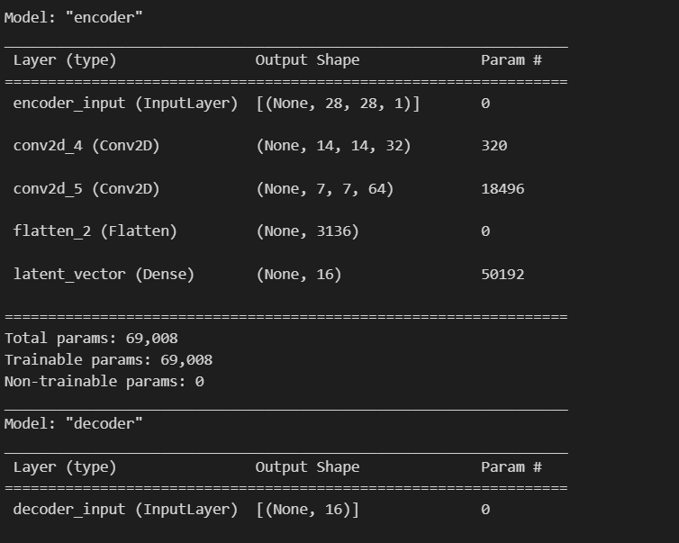
First Part: Default Source Code Explanation:
Sample code "Autoencoder for Denoising MNIST" Execution Result
Figure 1.1 illustrates a structural summary of an autoencoder model, which is divided into two components: the encoder and the decoder.
Fig.1.1

Slide 4
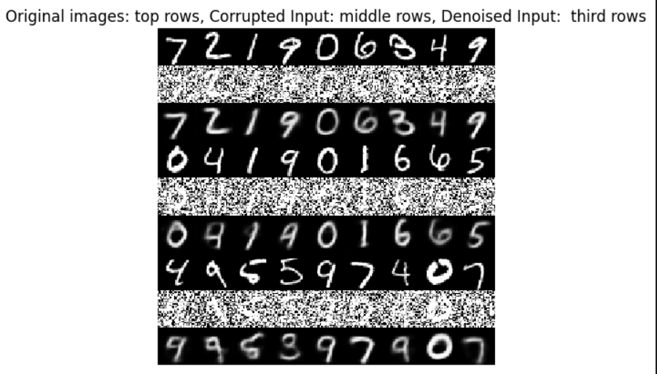
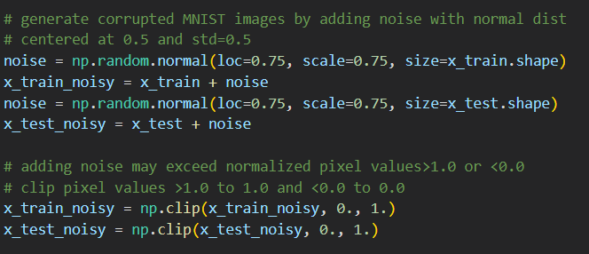
Figure 1.2: Generate normal distribution noise with a mean of 0.75 and a standard deviation of 0.75, with the same shape as the training and test sets.
Top row (Original images): Displays the original MNIST digit images without any noise interference, exhibiting high clarity.
Middle row (Corrupted Input): The images in this row have been contaminated with noise, simulating potential data quality issues in real-world conditions. Noise points are visible on each digit, causing the images to appear blurred.
Bottom row (Denoised Input): Showcases images processed by an autoencoder, where the model attempts to recover the original digits from the noisy input. The images in this row are significantly clearer compared to the middle row, indicating that the autoencoder has achieved some level of effectiveness in noise removal.
Fig.1.2
Fig.1.2 (code)

Slide 5
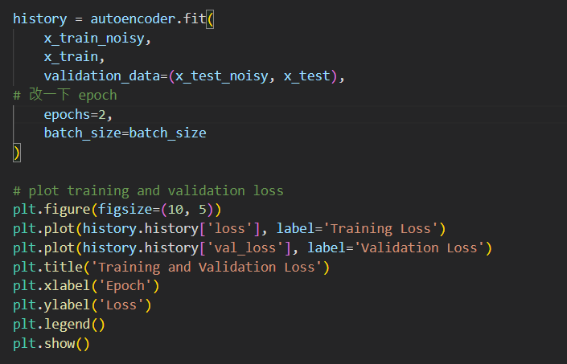
First Part: Default Source Code Explanation:
Plotting the loss graph during training
In the code, the autoencoder.fit() function is used to train the model, where x_train_noisy serves as the input data, and x_train serves as the target data. Additionally, x_test_noisy and x_test are used as the validation data set.
The default code sets the number of epochs during training to 2, and the batch size is set to batch_size.
After training is complete, the plt function from the matplotlib library is used to plot the training loss and validation loss. The history variable stores the loss values during the training process.
plt.figure() sets the size of the figure, plt.plot() draws the loss curves, and plt.title(), plt.xlabel(), plt.ylabel(), and plt.legend() respectively set the title, x-axis label, y-axis label, and legend of the plot. Finally, plt.show() displays the plot.

Slide 6
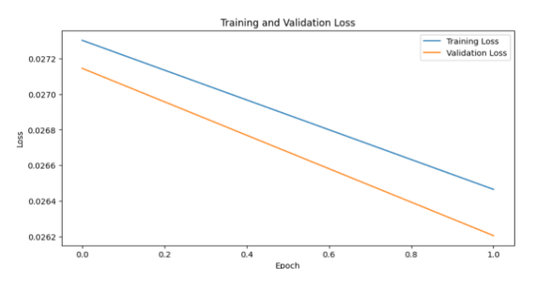
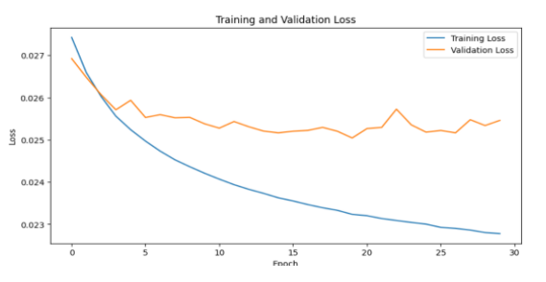
First Part: Default Source Code Explanation:
Analysis of the Loss Plot During Training - Adjusting Epochs to Understand the Trend of the Loss Plot
In the loss plot of Figure 1.3, if the training loss is greater than the validation loss and both are decreasing proportionally, it indicates a well-performing training process. However, in the default source code, the epoch is set to 2, which is insufficient to observe the entire training process. Therefore, this setting does not allow for a comprehensive assessment of the training performance of the autoencoder.
Fig.1.3
In Figure 1.4, to gain a clearer understanding of the entire loss situation, we increased the number of epochs to 30. It can be observed that around epoch 5, the training performance starts to approach its limit. The validation loss oscillates between 0.0252 and 0.0259, and the training loss gradually levels off below 0.0254.
It is anticipated that further training may not yield significant improvements, and there is a clear indication of overfitting as the training loss is noticeably lower than the validation loss. Therefore, it is suggested to stop training around epoch 4-5 to prevent overfitting.
Fig.1.4

Slide 7
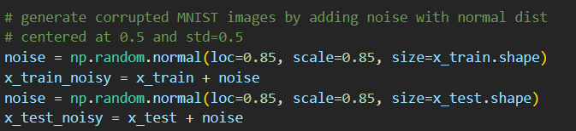
Second Part: Introducing Challenges for the Model in Dealing with Noise:
To increase the difficulty for the autoencoder, we adjusted the noise level from 75 to 85. All other hyperparameters of the model remain unchanged, and no additional data processing is performed. With the epoch set to 30, we observe the training results of the default model under these conditions.

Slide 8
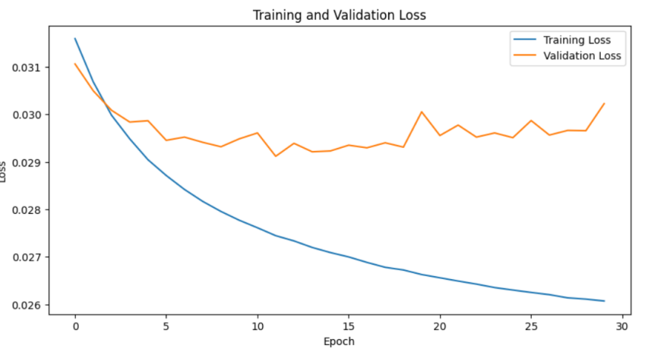
In Figure 2.1, it is evident that due to the influence of increased noise, the model quickly learns the probability of noise, leading to the onset of overfitting. The validation loss is noticeably greater than the training loss (highlighted in red), and the trend of the validation loss is increasing (highlighted in red circle), indicating a classic overfitting phenomenon.
Fig.2.1

Slide 9
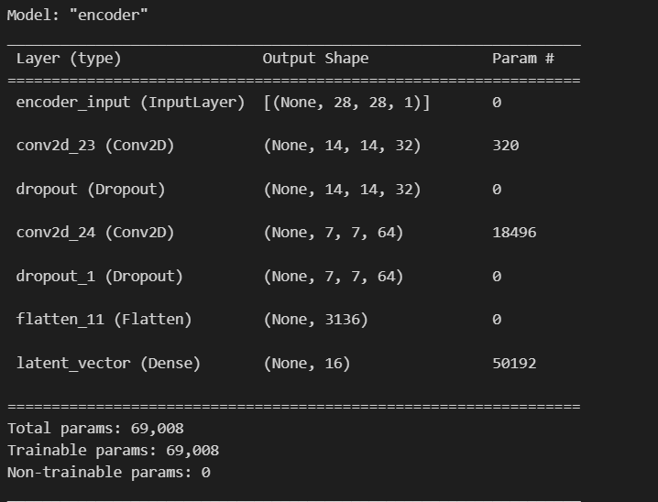
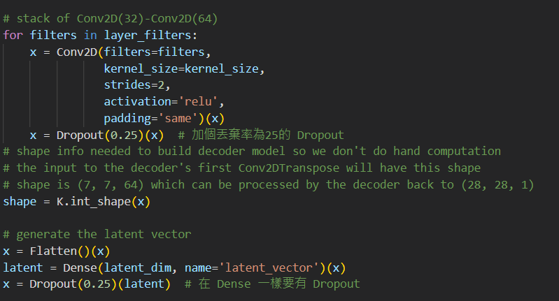
Third Part: Chosen Correction Method by the Team - Adding Dropout Layers to the Model
Explanation:
1. Dropout is a regularization technique primarily used to prevent overfitting in neural networks. Its working principle involves randomly "dropping out" (setting the output to zero) a portion of neurons' activities during training. This prevents the model from relying too heavily on any single input node, forcing it to learn more robust feature representations.
2. In practice, it is equivalent to randomly sampling a smaller network from a larger network during each training iteration. Different parts of the neural network are trained in different iterations, allowing different parts of the network to independently capture features in the data. This randomness helps the network avoid overfitting to the training data by preventing the model from overly relying on any single feature in the training set.
3. We treat Dropout as a layer (Dropout layer) and specify a dropout rate, which determines the proportion of neurons to be dropped out in each iteration. Common dropout rates range from 0.2 to 0.5 (we chose 0.25). The process of selecting an appropriate dropout rate is the result of multiple adjustments in our experiments.
fig2.1
]Adding a Dropout layer after the Conv2D layer: Forcing the entire model to learn more robust feature combinations. Also, adding a Dropout layer before the Dense layer to prevent overfitting caused by fully connected layers.

Slide 10
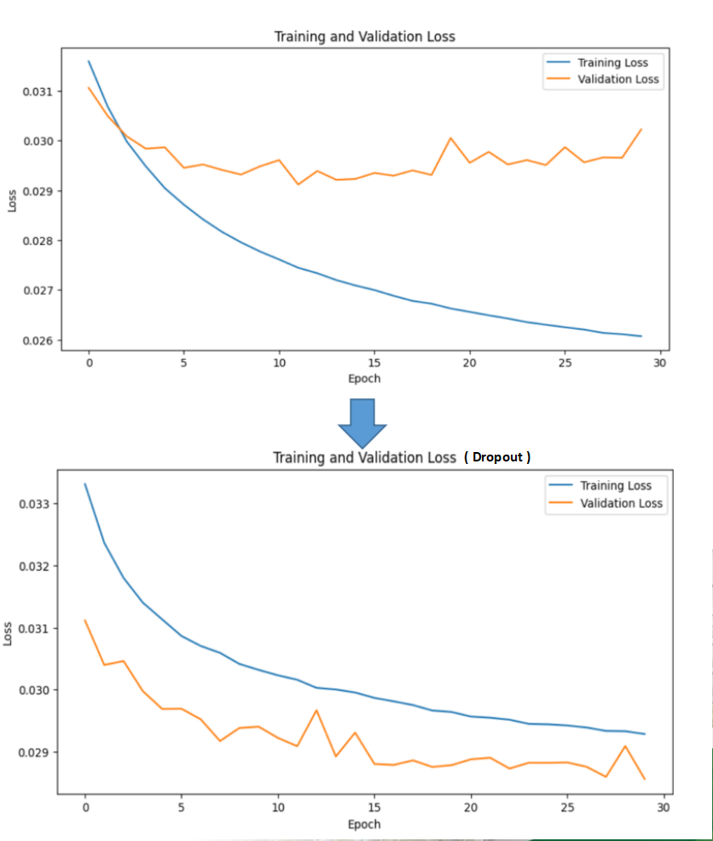
Third Part: The Chosen Correction Method by the Team - Adding Dropout Layers to the Model
The results indicate that Dropout significantly contributes to reducing the difference between training loss and validation loss. This not only implies that the model has better generalization ability for unseen data but also demonstrates that Dropout can serve as an effective tool to combat overfitting.

Slide 11
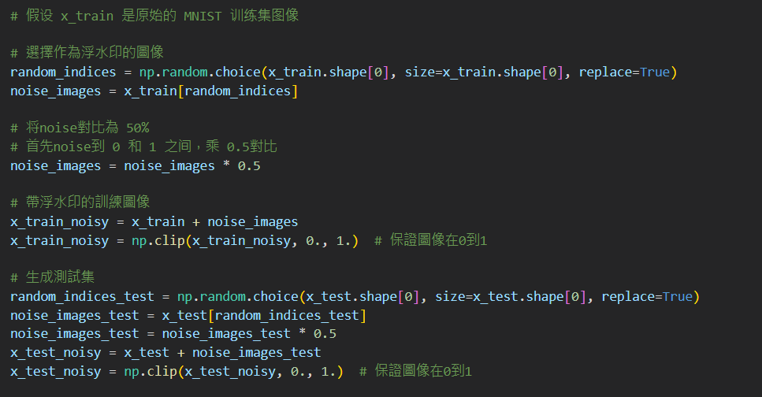
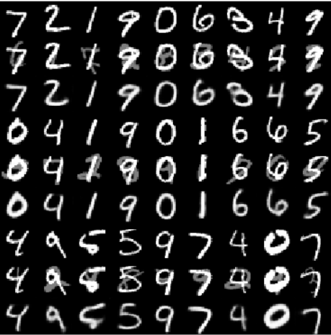
Fourth Part (Appendix): Application of Our Autoencoder Model in Watermarking
Simulating watermarking with the original noise representation:
We used random digits from the MNIST dataset and adjusted the contrast to 50%. This modified representation replaced the originally generated noise, mimicking the effect of a watermark.

Slide 12
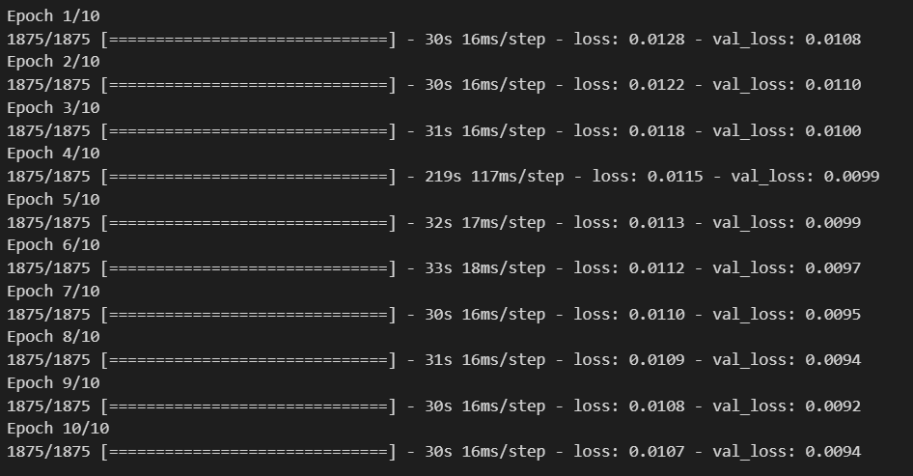
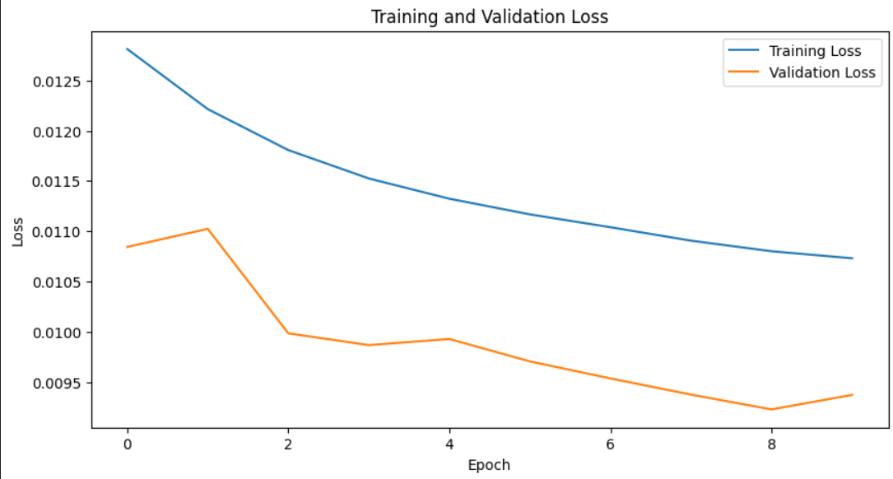
Fourth Part (Appendix): Application of Our Autoencoder Model in Watermarking
The successful outcome with Epoch = 10 indicates that our autoencoder model is not only effective in denoising but also capable of removing watermarks effectively.

